Slide 1
Condensed Representation of Incidence Matrix for Directed Graph with Self-Loops
Yash Sharma - IHM2014006
Aditya Kumawat - ICM2014001

Slide 2
Overview
Proposed Representations of Incidence Matrix
Base Representation
Base Representation with Destinations
Bit Encoding
Vector<Pair> Representation

Slide 3
Base Representation
N - no. of vertices E - no. of edges
Matrix ’A’ of size N x E
Initialize all values with 0s.
For every edge ’e’ starting from vertex ’v1’ to ’v2’,
A[v1][e] = 1
A[v2][e] = 2.
For self-loops at vertex ’v’,
A[v][e] = 3

Slide 4
Base Representation with Destination
N - no. of vertices E - no. of edges
Matrix ’A’ of size N x E
Initialize all values with -1s
For every edge ’e’ from vertex ’v1’ to ’v2’,
A[v1][e] = v2.
For self-loops at vertex ’v’,
A[v][e] = v.

Slide 5
Bit Encoding
N - no. of vertices E - no. of edges
Array ‘B’ of size N
Initialize all values with 0s.
Calculate Quaternary numbers for every vertex ’v’ by appending values of every column in A[v] row.
For every vertex ’v’,
B[v] = conversion of Quaternary number to Decimal number.

Slide 6
Vector Pair Representation
Define a new Data Structure as a vector of pairs of integers
Vector<Pair<int, int>>
For every edge ’e’ between ’v1’ and ’v2’,
If A[v][e] = 1 Then v1 = v;
If A[v][e] = 2 Then v2 = v;
If A[v][e] = 3 Then v1 = v & v2 = v;
Push Pair (v1, v2) to Vector

Slide 7
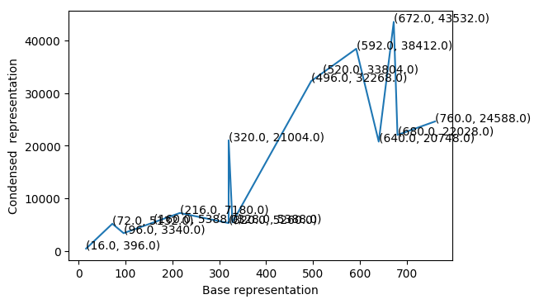
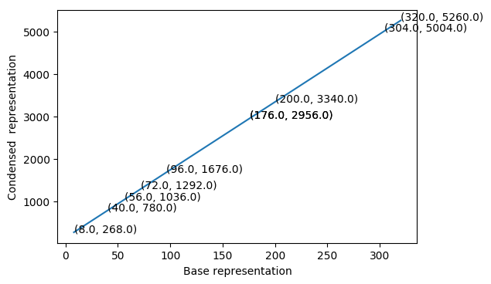
Results
Base Representation
For N and E,
Vector<Pair> representation is better in terms of space complexity.
When E >> N, condensation is not achieved as expected
When N ~ E, condensation is achieved as expected
Condensed Representation
Base Representation
Condensed Representation

